Slide 1
DATA SCIENCE PROJECT
PRESENTED BY:
YASH NARAD
SECTION A 7th SEM
PRN:22070521048

Slide 2
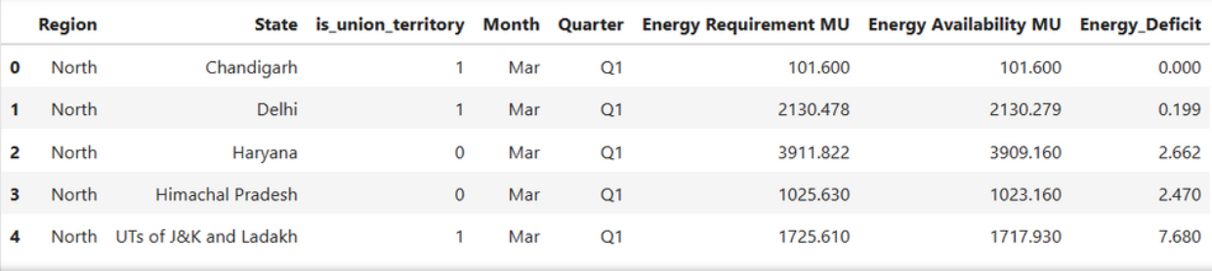
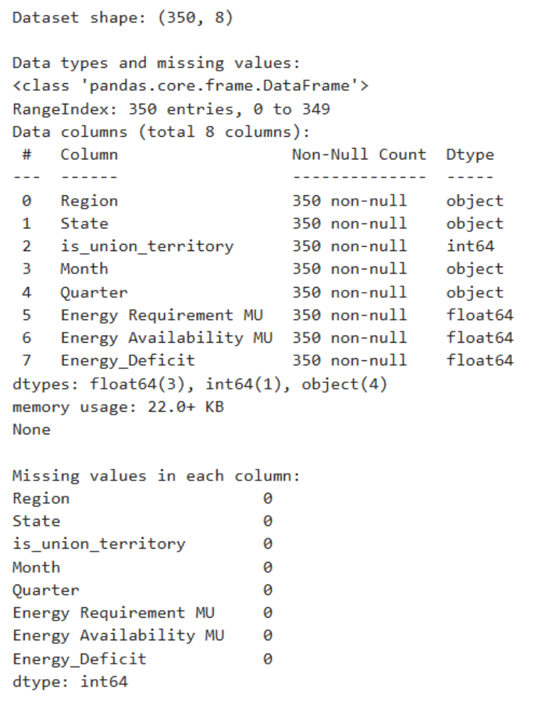
ABOUT DATASET
DATASET OVERVIEW:
INDIA'S ENERGY PROFILE (TIME SERIES DATA)
Goal: Conduct a data-driven study on India's Energy Requirements and Availability for predictive planning.
DATA SCOPE & PROVENANCE:
•Source: open government data (ogd) platform India .
•Source authority: ministry of power, government of India.
•Dataset Name: energy requirement and availability.
•Coverage: data for various states and uts.
•Nature: time-series dataset, capturing long-term trends and fluctuations.

Slide 3
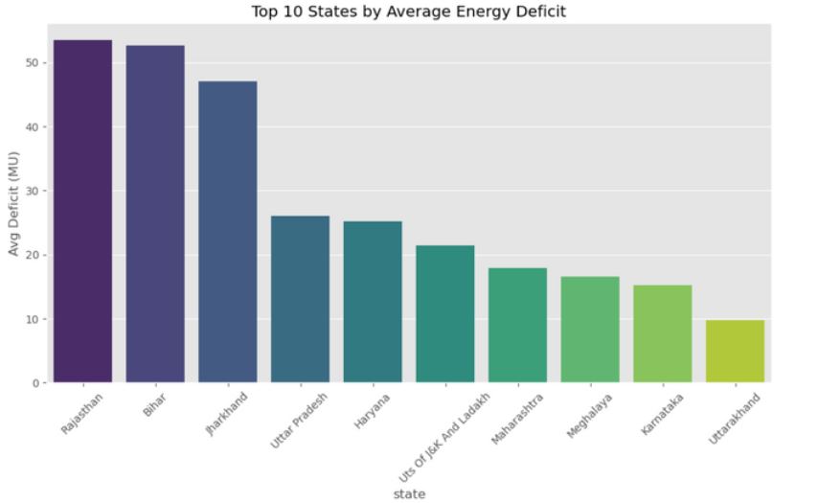
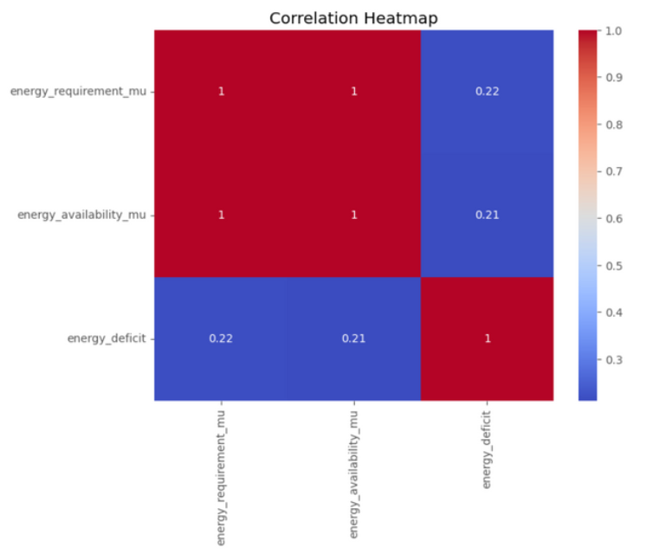
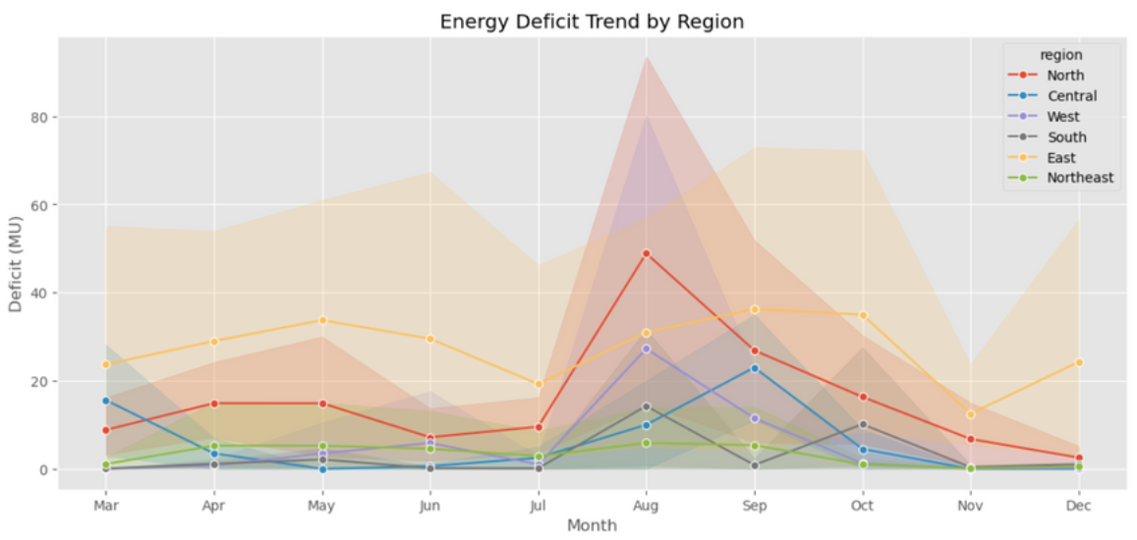
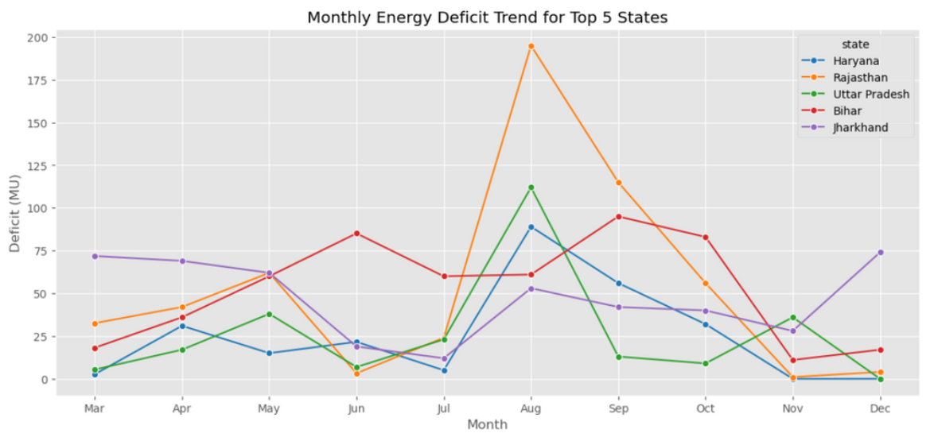
INSIGHTS FROM EXPLORATORY DATA ANALYSIS
key findings from the dataset :
  Identified key trends and patterns.
  Analyzed correlations between variables.
  Visualized data using graphs and charts.
  Highlighted outliers and anomalies present.
  Summarized statistical findings for clarity.

Slide 4
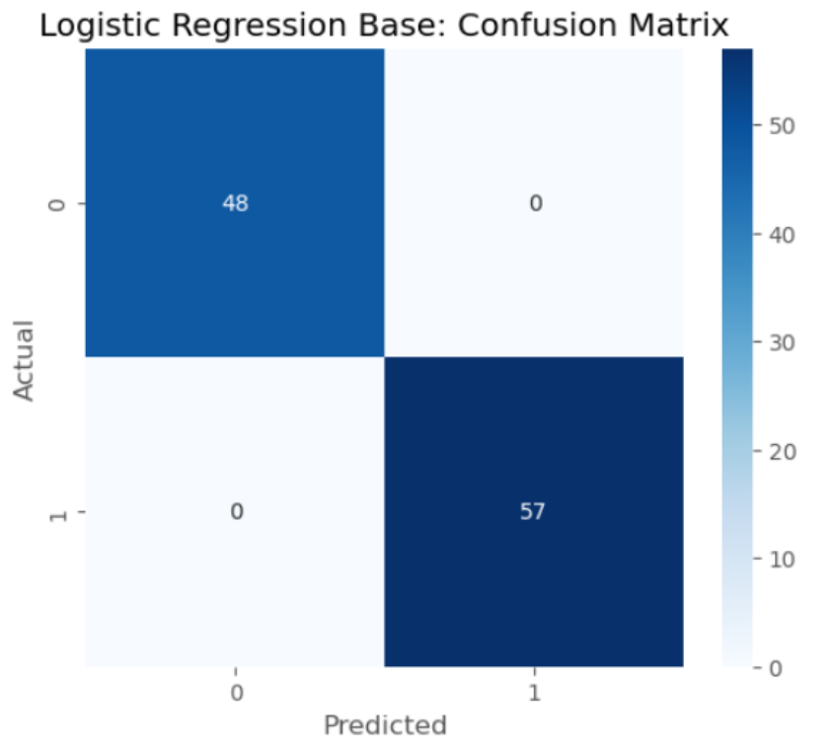
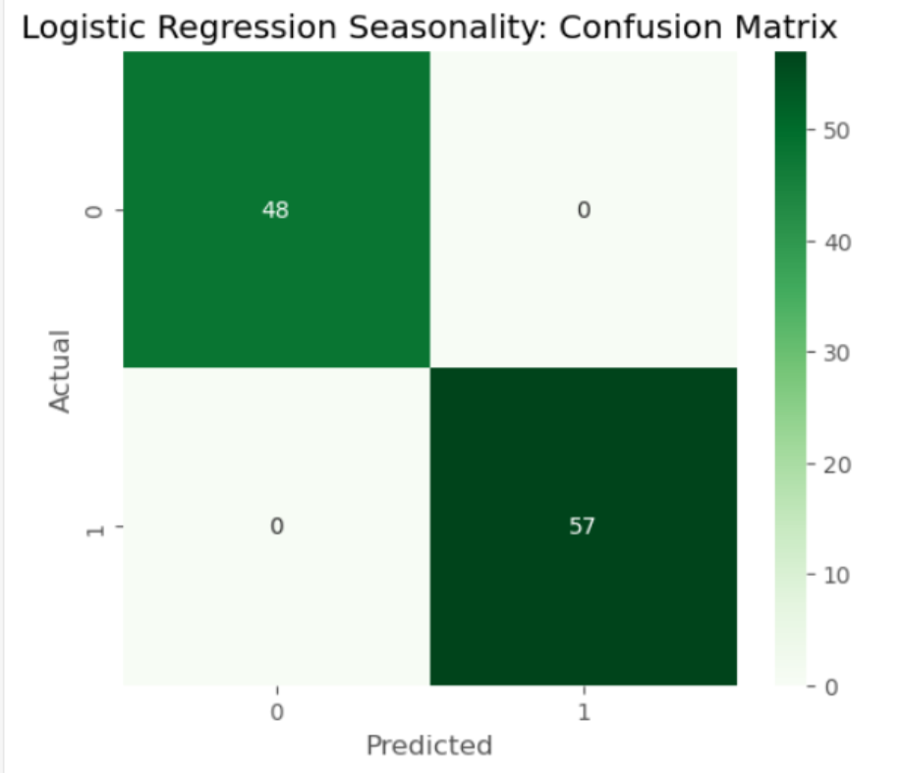
MODEL 1 : Logistic Regression
Logistic Regression Base Accuracy: 1.0
Logistic Regression Seasonality Accuracy: 1.0
Overall Conclusion Logistic Regression is an ideal classifier for this problem, achieving 100% accuracy. Similar to the Naive Bayes results, this performance suggests that the underlying relationship between the input features and the target class is simple and highly distinct. The Base LR model is the most parsimonious choice due to its perfect performance with fewer features.

Slide 5
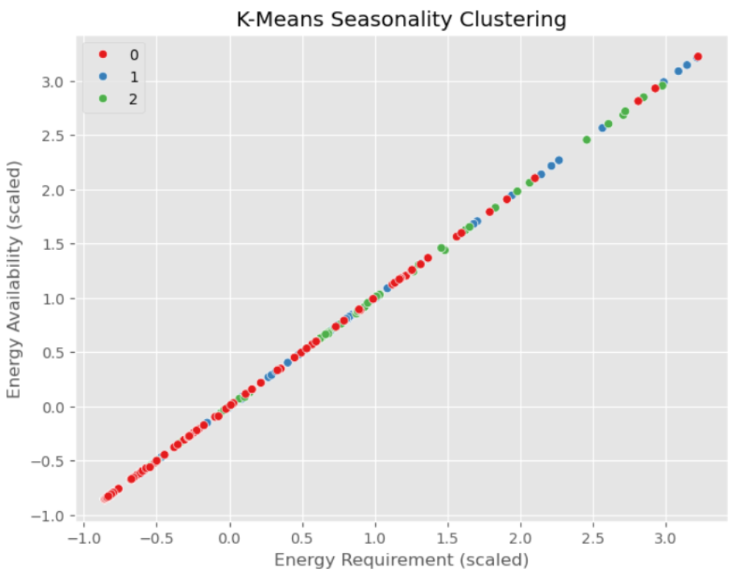
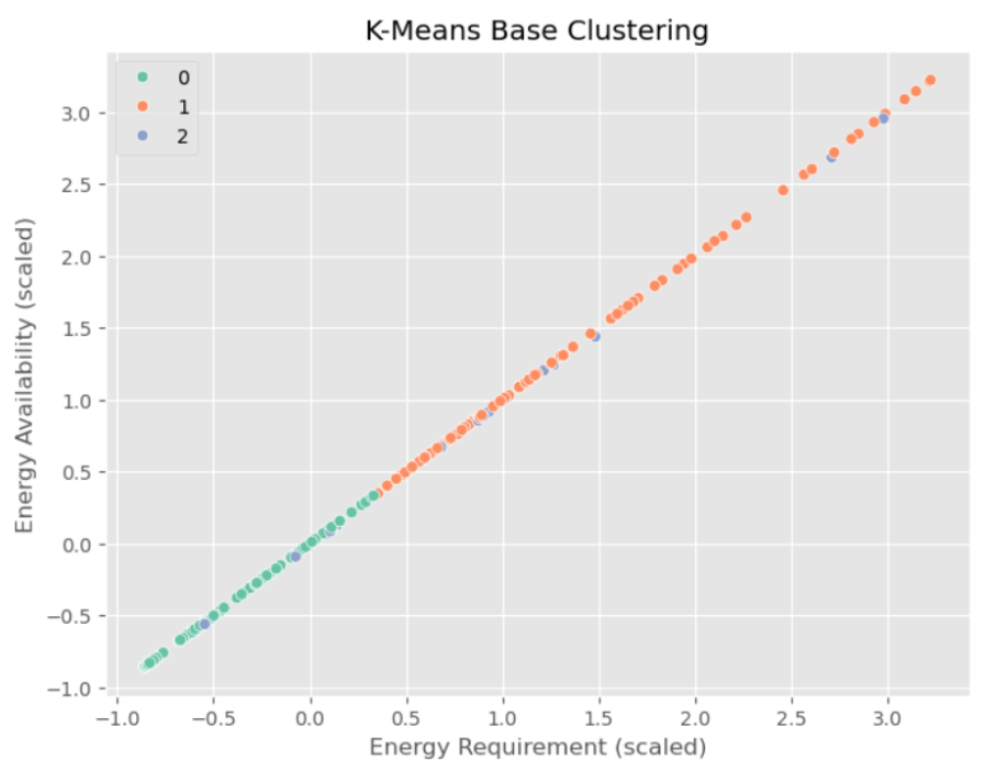
MODEL 2 : K-Means Clustering
K-Means Clustering is an unsupervised machine learning algorithm that helps group data points into clusters based on their inherent similarity. Unlike supervised learning, where we train models using labeled data, K-Means is used when we have data that is not labeled and the goal is to uncover hidden patterns or structures. For example, an online store can use K-Means to segment customers into groups like "Budget Shoppers," "Frequent Buyers," and "Big Spenders" based on their purchase history

Slide 6
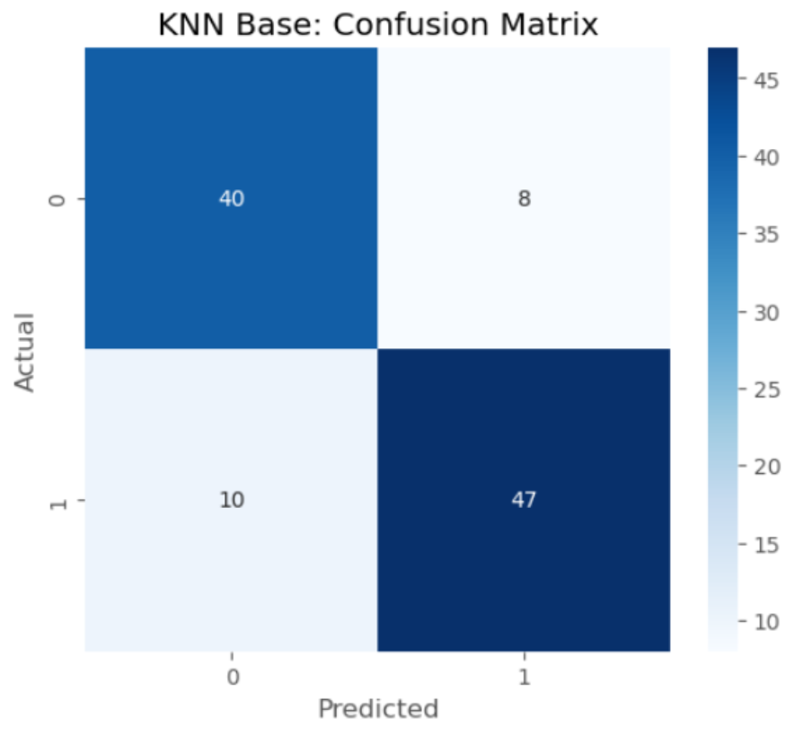
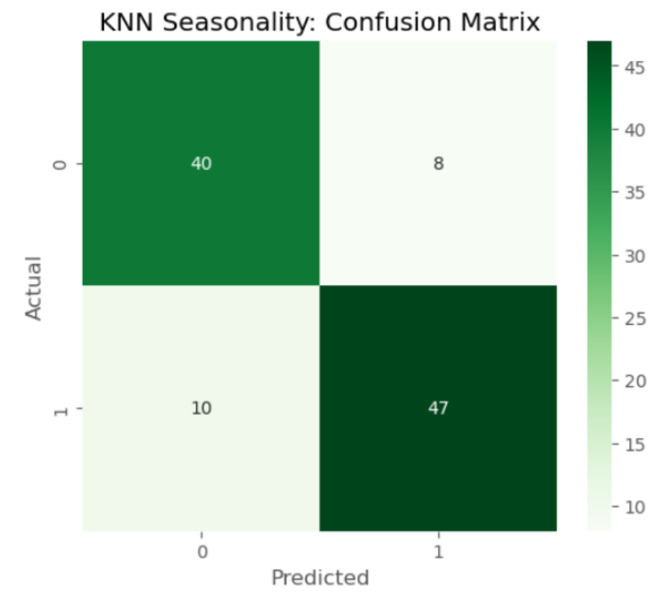
MODEL 3 : KNN Classifier
KNN Base Accuracy: 0.829
KNN Seasonality Accuracy: 0.829
Summary The KNN models are reasonably accurate (82.9%) and perform consistently well across both classes (Recall ≈ 83.3% for Class 0 and 82.5% for Class 1). Crucially, the analysis reveals that seasonality features did not add predictive value to the base KNN model, suggesting that the spatial/locational features alone are sufficient for this level of classification performance.

Slide 7
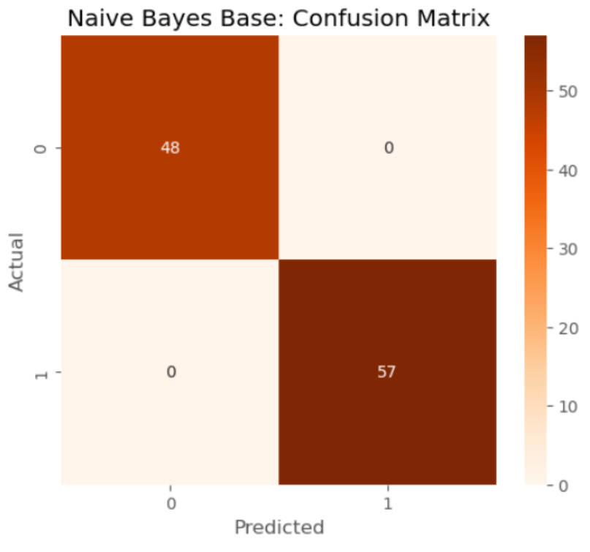
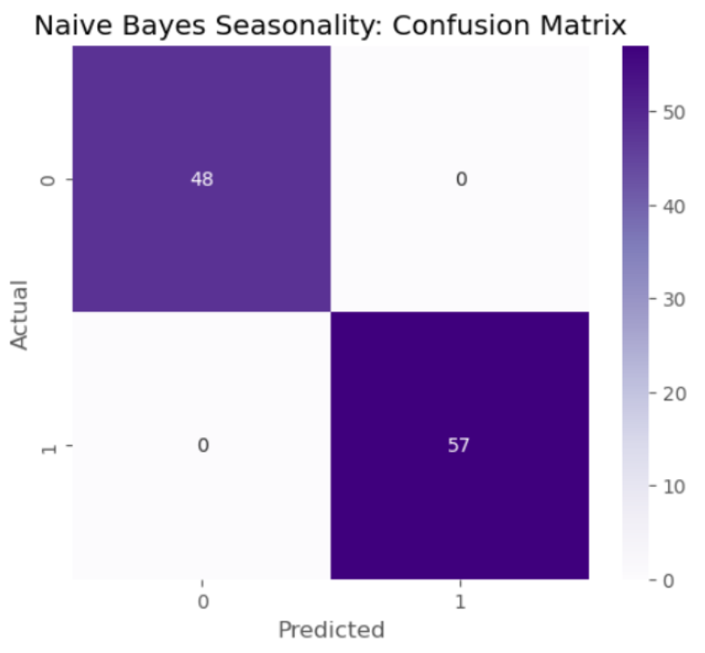
MODEL 4: Naive Bayes
Naive Bayes Base Accuracy: 1.0
Naive Bayes Seasonality Accuracy: 1.0
Overall Conclusion The Naive Bayes model is an ideal classifier for this problem, achieving 100% accuracy in distinguishing between the two classes. Given the perfect result, the simpler Base NB model is the most efficient choice, as the added complexity of seasonality features provides no benefit.

Slide 8
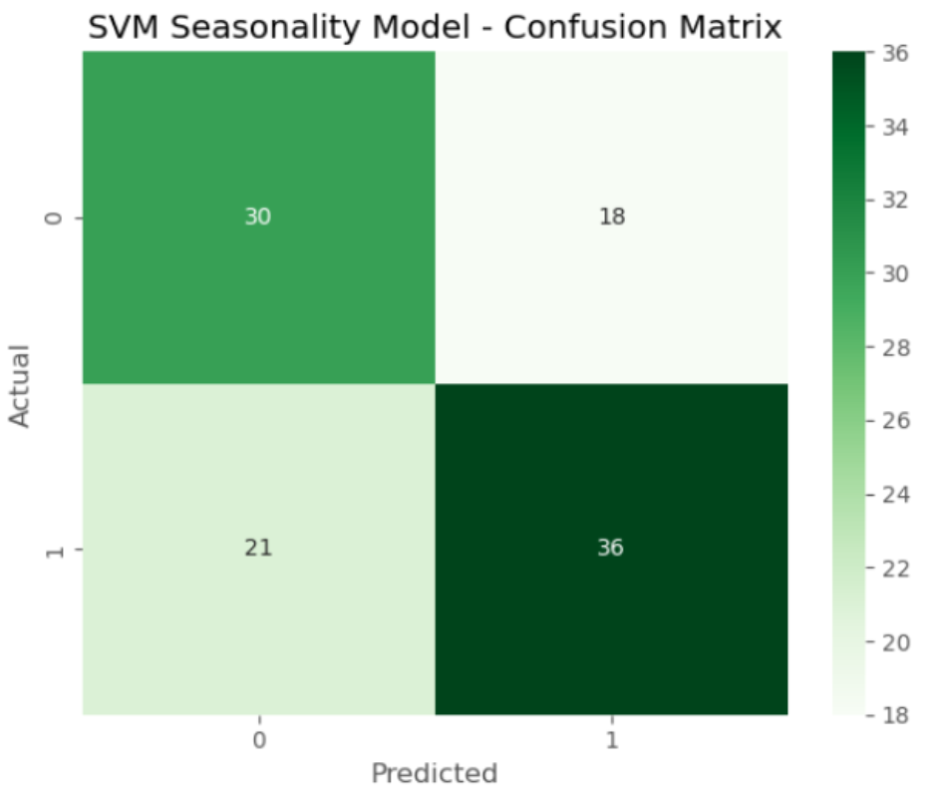
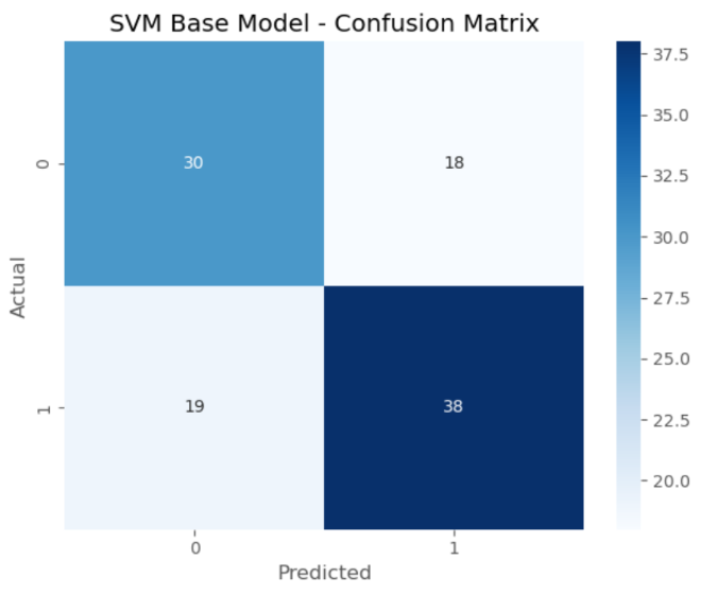
MODEL 5 : Support Vector Machine
SVM Base Model Accuracy: 0.648
SVM Seasonality Model Accuracy: 0.629
Summary The SVM model is a poor classifier compared to the others tested (Logistic Regression, Naive Bayes), suggesting that the data is not easily separable by a fixed linear or polynomial boundary. Furthermore, the Base SVM is superior, confirming that the seasonality features are **detrimental to the SVM’s performance**.

Slide 9
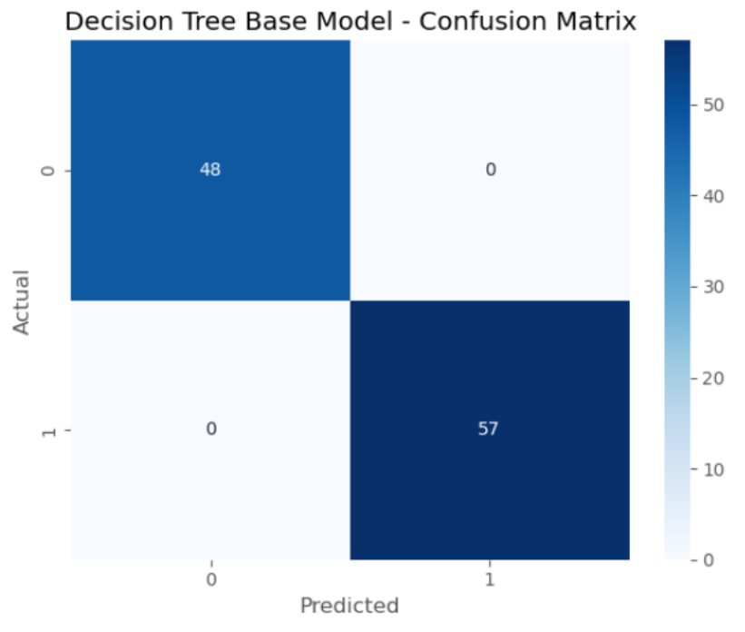
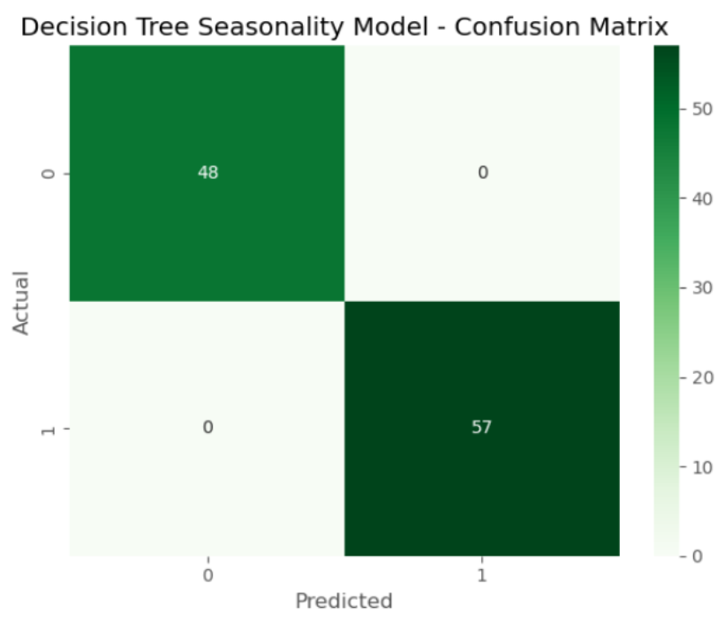
MODEL 6 : Decision Trees
Decision Tree Base Model Accuracy: 1.0
Decision Tree Seasonality Model Accuracy: 1.0
The Decision Tree Model Is The Most Interpretable And Efficient Classifier Among The Perfect-scoring Models. Its Single-split Structure Demonstrates That The Binary Target Is Perfectly Determined By A Trivial Threshold On The Gap Feature. As Seen With Other Models, Seasonality Features Were Redundant.

Slide 10

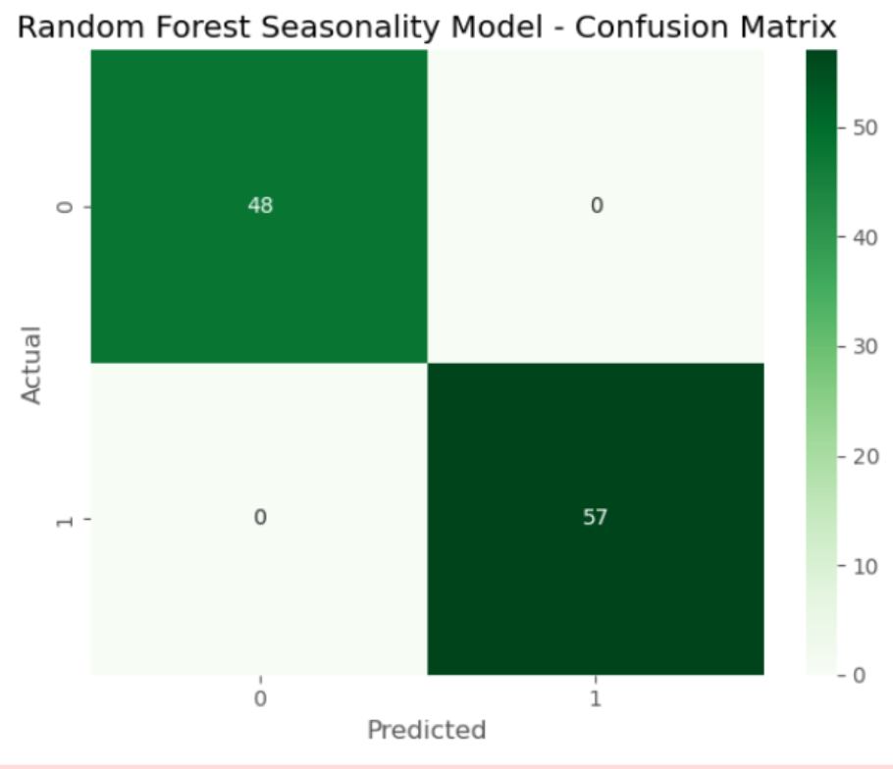
MODEL 7 : Random Forest
Random Forest Base Model Accuracy: 1.0
Random Forest Seasonality Model Accuracy: 1.0
Overall Conclusion The Random Forest classifier performed perfectly, confirming the results from other robust models. Since the Decision Tree achieved perfect performance with a single simple split on the gap feature, the Random Forest ensemble technique, while more complex, does not offer a predictive advantage here. Given the perfect scores, the Base RF model is the preferred choice for its simplicity over the Seasonality RF model.

Slide 11

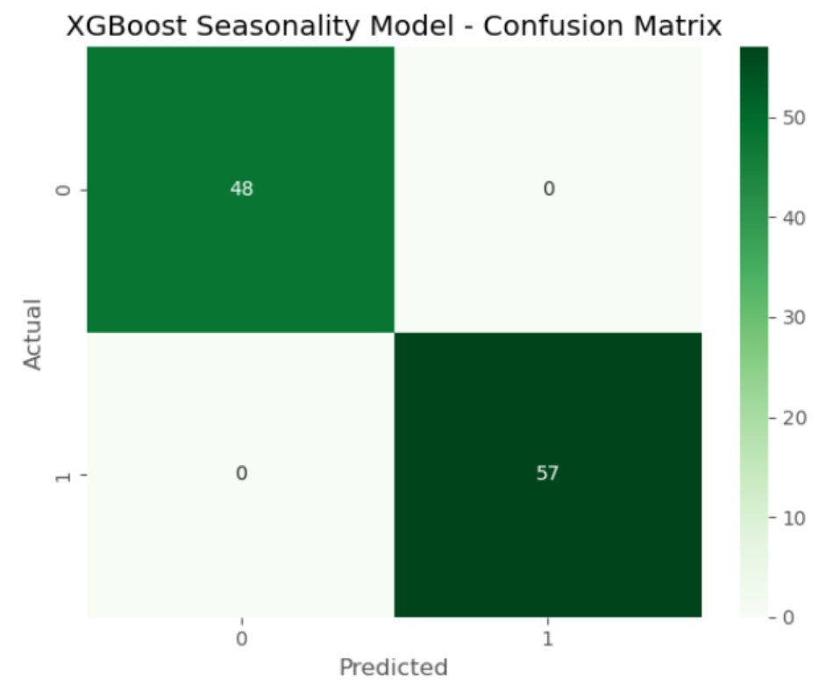
MODEL 8 : XGBoost Classifier
XGBoost Base Model Accuracy: 1.0
XGBoost Seasonality Model Accuracy: 1.0
Overall Conclusion XGBoost, a powerful boosting ensemble, confirmed the perfect classification achieved by simpler models. Given that the Decision Tree achieved perfection with a single split, the highly complex structure of XGBoost is unnecessary for this problem. The Base XGBoost model is the preferred choice over the Seasonality version, as the added seasonal features provide no benefit.

Slide 12
Thank You 1

